Slide 1


Technical Presentation | JREDA
Strategic Assistance to JREDA in meeting its ambitious RE targets of 4,000 MW by 2027
Proposal for setting-up of Strategic Program Management Cell for JREDA for initial period of Two Years
September 2023

Slide 2
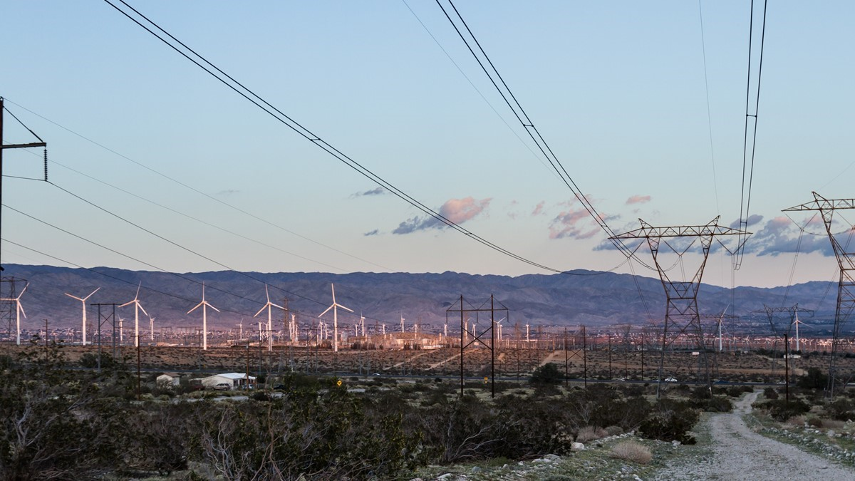
CONTENTS
Jharkhand Scenario
Project Implementation Framework
Deloitte Experience in RE Sector
Approach & Methodology
Meet The Team

Slide 3

Jharkhand Scenario

Slide 4
Changing Trends in Jharkhand RE Sector
Vision of the State Govt of Jharkhand
Energy transition and reforms to support such transition
Contribute to India’s clean energy ambitions
Reduction of total projected carbon emissions
Increase the share of solar electricity in State’s power purchase portfolio
Help DISCOMs meet its RPO trajectory
Provide investment avenues for private players
Collaboration with the Government to invest in RE projects
Empowering rural population by providing access to clean and affordable energy
Jharkhand Solar Policy 2022
Jharkhand EV Policy 2022
Jharkhand Power Policy 2023 (Draft)
4,000 MW by 2027
Utility Scale: 3,000 MW
DRE: 720 MW
Off Grid: 280 MW
10% share of EV in the State by 2027
50 charging stations per million population
Power generation hub of India with surplus power by 2026
Promote & create enabling environment for RE development within the State
Economic development of the state by favoring EV manufacturing sector & establishing Jharkhand as an EV hub in India
Encourage Energy transition, Promote RE generation, DRE, pumped Hydro storage & Energy Conservation
JREDA’s Presence in RE Sector
Implemented Projects | Identified Priority Areas
Solar Rooftop (Government Building) | Solar Park 80 MW
Solar Water Pumping System | Solarization of Airports, 5 Nos. of Airport
PM-KUSUM Scheme Component-B | Solar City Giridih
Village electrification program | Floating Solar 600 MW
Solar Home & Street Lighting System | 13 small hydro electric potential site of 125 MW
High Mast Solar Light | Canal Top Solar
Source: CEA Installed capacity report
Notes:
1 - 3.6 (2021-22)
2 - 6.1 (2016)
5 – 5.7 (2021)
Assessment of substation-wise solar power capacity • Review of substation infrastructure through site surveys • Identification of technical approvals, various technical risks (network and site related) and issues • Analyse the load requirement, project size, and identify most suitable locations in the state to set up ground mounted solar plants to feed into the segregated agriculture feeders. •Technical evaluation of the proposals received in the competitive bidding process

Slide 5
Project Implementation Framework
Utility Scale Solar
Rooftop Solar
Solar Agri Pumps

Slide 6










RE Project Implementation Framework – Solar Park, Floating Solar Park
Development of Utility scale solar projects
CURRENT ENDEAVORS & LANDSCAPE
KEY CHALLENGES
OUR EXPERTISE
Solar Park
Upcoming 04 Solar Parks of 20 MW
(Palamu, Simdega, Garhwa, Deoghar)
Land acquisition & aggregation
Capacity Overhang of legacy PPAs that are costly
Limited traction on developing Floating Solar project portfolio
Lack of Private Investments
Understanding modalities of various implementing models
Power Evacuation & Offtake issues
Floating Solar
600 MW (Chandil) & 400 MW (Tenughat) Floating solar plants in pipeline
DPR of 950 MW Ground Mount Solar Park, Chhatarpur, MP
Canal Top
400 MW Canal Top Solar underway
DPR & TA World’s largest 600MW floating solar park, Omkareshwar
Solarizing
the Airport
05 Airport solarization projects
(Dhanbad, Dumka, Deoghar, Giridih, Bokaro)
ENVISAGED SOLUTIONS
Installed RE Capacity
139.90 MW
(CEA, August 2023)
Transparent Land aggregation and allotment policy needs to be formulated in line with States like MP, Karnataka
Large scale scoping of Solar Parks & Floating Solar Parks
Utility Scale RE Projects could be scoped typically for meeting captive demand of industries
Techno-Commercial due diligence of Odisha Solar Park (IFC & GEDCOL)
Target RE Capacity
3,000 MW
(Solar Policy 2022)
Key policy & regulatory initiatives to promote utility scale Solar projects in State
Standard Operating Procedure in place
State Level Screening & Empowered Committee
Regulatory Framework by JSERC (RPO, Net Metering, OA) regulations
Key
Efforts
Support to DMRC-750 MW procurement solar power from REWA Solar Park

Slide 7









RE Project Implementation Framework – Rooftop Solar & Solar Agriculture
Development of RTS in Jharkhand in Govt & Private sectors (Residential, Commercial, Industrial) & Agriculture Pumps
CURRENT ENDEAVORS & LANDSCAPE
KEY CHALLENGES
OUR EXPERTISE
Rooftop Solar (RTS)
25 MW of Grid Connected RTS in different government Buildings
Demand aggregation across Government and C&I consumers untested
Low response from vendors during empanelment
Paucity of investors
Lack of awareness among consumers
Consumers inclination towards hybrid mode of RTS
100% RE Cities - Ayodhaya, Amritsar, Gandhinagar & Trivandrum
Solar
City
‘Giridih’, 17 MW of grid connected RTS under MNRE Phase 2 Programme
PM-KUSUM
Component-B
Successful implementation under the PM KUSUM Scheme (Component-B)
Transaction Advisory 17MW Gross Metered RTS across 17 cities in Odisha
Solar Agri
Pumps (AG)
20,000 AG pumps sanctioned under PM KUSUM-B in 2 phases
ENVISAGED SOLUTIONS
Preparation & Operation of Unified RTS portal for HimUrja and OREDA
Installed RTS Capacity
~ 25 MW
(August 2023)
Higher targets to be established vis-à-vis RTS potential
Rationalize Vendor empanelment process as per learnings from Gujarat, Kerala
Integrated RTS portal
Adoption of successful initiatives for “SOLAR CITY” across INDIA to other cities for larger adoption within the State
Target RTS Capacity
250 + 250 MW
(Solar Policy 2022)
TA - 1st 4MW Net-Metered Rooftop solar project in Bhubaneshwar & Cuttack
Key policy & regulatory initiatives to promote RTS in State like Solar Policy, JSERC Net Metering Regulations, RTS in Govt. Building is in progress etc.
Facilitation of subsidized & non-subsidized consumer categories for RTS adoption under process
Key
Efforts
Assistance to JBVNL, JVVNL DISCOMS, GIZ, MNRE in AG Scheme implementation

Slide 8

RE project implementation framework – New and advanced technologies
Pilot new technologies like floating solar, wind-solar hybrid, storage solutions (Battery, pumped storage)
Hybrid & Round the Clock (RTC)
Pumped Storage
Deloitte’s Value proposition
Priority and special incentives proposed for hybrid and RTC RE projects
Off-the-river closed loop pumped storage projects
Our Support to UP Government
Supported in framing of draft green hydrogen policy of Uttar Pradesh
Battery Energy Storage System
Emerging Options
VGF proposed for BESS to be developed by Dept of Industries, GOJ. State to promote RE projects with storage.
Green Hydrogen
Facilitated Investments in PSH and green hydrogen in UP
Proposed development of Green Hydrogen / Ammonia hubs. JREDA / DISCOMs to supply RE power for Green Hydrogen production at cost plus margin
Our Support to Odisha Government
Financial and Economic analysis of Upper Indravati Pump Storage Project (PSP) in Odisha, India
Key Factors of Preparedness
Coordination between stakeholders, depts
Piloting innovative models
Resource Assessment & Alignment of JREDA’s requirements
Notes:
Supported draft green hydrogen policy of Uttar Pradesh, facilitated investments in OSH and green hydrogen in UP

Slide 9
Why Deloitte
We bring onboard relevant experience and subject matter experts to handhold you in this engagement

Slide 10
Deloitte’s varied experience with states- SNA/IT/Program Management
Rich experience of providing implementation support through program management, IT dashboard
Deloitte’s Diverse Portfolio of RE projects
We have a valued portfolio of supporting states in implementation of policies through digitalisation of solar rooftop application processes; supporting PMUs for Utilities & SNAs; IT handholding support for DISCOMs
Web portal, web dashboards
Project Monitoring Support Unit to support activities of SNA/DISCOM
IT
Project management
24x7Power for All Plan
Solar Rooftop PV Policy Implementation support
SNA
Programme Management
Support for Central/state governments for RE Plans/ Cities
Solar City, IT
Solar City, IT
Work closely with SNA for adoption of RE
Project Management Unit
24x7Power for All Plan
Solar City, Web dashboard
Project Management Unit, Web portal
Developing RE city plan, Power for all plan, developing energy database for cities etc.
Solar Rooftop PV Policy implementation support
Solar Rooftop PV Policy Implementation support
Project Management Unit
Management & monitoring of various govt schemes like PM KUSUM, DDUGJY, IPDS etc
Solar City, Solar rooftop policy
24x7Power for All Plan
Project Management Unit, Web based portal
24x7 Power for All Plan
Mobile Apps, Web applications, AMC for Hardware, AMC data center services to maintain the Data Center

Slide 11


Deloitte’s experience with states- Solar park, distributed solar/new areas
Rich experience of working closely with SNAs & experience in solar park, DRE and other emerging technologies
We have been pioneers in executing some first of its kind projects in India
Solar Park
Distributed Solar/New Areas
Karnataka
Odisha
Madhya Pradesh
Maharashtra
Rajasthan
Uttar Pradesh
Bihar
Gujarat
Maharashtra
Odisha
Andhra Pradesh
Rajasthan
Himachal Pradesh
Punjab
Jharkhand
Kerala
DPR development & transaction advisory of 600MW floating solar at Omkareshwar Dam
Transaction and bid process support under KUSUM C for Rajasthan DISCOM, Rooftop Solar
First 5 MW solar rooftop project under PPP mode under Gross metering
Emerging Areas
Strategy and Blueprint for ‘Green Hydrogen’ for India’s largest power production PSU
Battery storage integration with wind/solar for A&N Island decarbonization
Design of first battery storage applications to operate at distribution end (BRPL/DERC)
Formulation of Green Day Ahead Market (G-DAM) & G-TAM regulations
‘Solarization of Agriculture Feeders under component C of PM-KUSUM scheme – IFC/SECI
Experience with Solar parks
Project monitoring & vendor management through IT intervention
Commercial & Regulatory due-diligence of solar parks
Investment review and evacuation infrastructure planning
Transaction advisory for hybrid and floating solar technologies
Solar park investment appraisal, Rooftop Solar, PM KUSUM
5 MW solar rooftop project under net metering
First Pre feasibility study for 500 MW solar park
1000 MW Solar Park
Evaluate feasibility on ‘Solarization of Agriculture Feeders under component C of PM-KUSUM scheme

Slide 12






Key assignments in Renewable Energy
Deloitte is a leader in providing consultancy and transaction services for Renewable Energy projects in India.
World’s largest floating solar park of 600 MW in Omkareshwar, Madhya Pradesh
Supported in Technical & Financial Assistance, Bid Advisory, DPR preparation
India’s first PPP Rooftop Solar Project in Gandhinagar – replicated to 19 cities in Odisha
Supported in Technical assessment, policy, regulatory & commercial due diligence, Bid Process Management
Transforming selected Indian cities to 100% RE cities Amritsar, Gandhinagar, Ayodhya & Thiruvananthapuram
Assisted in Strategy ,Technical potential assessment, Bid Process Management
India’s first interstate RE PPA -procurement of 750 MW for Industrial Consumers
India’s first net metering regulations- CERC Regulations
Supported in measures for effective implementation of pre-paid metering in India
Support UPNEDA in Policy Formulation- Solar Energy, Bioenergy, Green Hydrogen
Supported in drafting Renewable Energy Policy of Uttar Pradesh.
Our Footprints across Jharkhand Energy Sector
Deloitte will use its expertise, rich experience across the entire Jharkhand Energy Landscape & understanding of the Jharkhand Energy Sector to provide Strategy Support to JREDA to meet the States Policy Objectives & also make Jharkhand a Renewable Energy hub conducive for private investments.
Particulars | GOJ Energy Dept | JREDA | JBVNL | JUUNL | TVNL
Bid Process Management | - | - | Y | - | -
Program Management | - | - | Y | - | -
Monitoring, Implementing State & Central Govt. Schemes | Y | - | Y | - | -
Regulatory Support | - | - | Y | Y | Y
Techno Commercial Assistance | - | - | Y | Y | Y
Policy, Manuals, SOP’s, Org Restructuring | Y | Y | Y | - | -
Stakeholder Management, Financial Assistance Support | - | Y | Y | - | -

Slide 13
Approach and Work Plan
Key Deliverables with Project Monitoring Methodology

Slide 14
Our Approach
Assess
Design
Implement & Monitor
Discussion with JREDA
Technical Capabilities assessment
Program management practices
Our team will design the implementation of the identified recommendations:
Need for Policy & Regulatory Changes
Best practices for planning, execution, and monitoring
Need for program management support, including coordination with available resources
Handholding Support in driving policy and regulatory changes
Support in survey/studies for feasibility of proposed RE Projects
Bid Advisory Support
Project monitoring support
Stakeholder Management
Offtake-Support
Engagement Objective
Support JREDA in implementation of various RE Projects in line with Jharkhand Solar Policy 2022 Objectives
PMU support on key sectoral activities carried by JREDA
Policy and Regulatory Support
Techno-Commercial Support
Program Management
Project Monitoring
Stakeholder Management
Assist in tapping opportunities in emerging areas like Green Hydrogen, Energy Storage etc.
Research/study
Review of existing policies and regulations
Understand their scope, effectiveness, and impact
Outcome
Outcome
Outcome
Gap Analysis of JREDA's current RE policies, regulations, & initiatives
Roadmap for implementation support, resource requirements, & M&E mechanism
Periodic Progress Reports on tracking milestones agreed with JREDA.
Key Deliverables
Monthly progress reports
Regular updates with analytical outputs to JREDA management
Replying to other requests from JREDA
Draft & Final yearly report

Slide 15
Our Workplan to Support JREDA – Key Activities
Indicative workplan which shall be finalized in discussion with JREDA
Activity | Deliverable / milestone | M 1 | M 2 | M 3 | M 4 | M 5 | M 6 | M 7 | M 8 | M 9 | M 10 | M 11 | M 12 | M 13 | M 14 | M 15 | M 16 | M 17 | M 18 | M 19 | M 20 | M 21 | M 22 | M 23 | M 24
Component 1 | Policy & Regulatory Support
Task 1 | Project Kick-off Meeting
Task 2 | Inception Report | ê
Task 3 | Review of existing policies and regulations
Task 4 | Technical Capabilities Assessment
Task 5 | Program Management Practices Assessment
Task 6 | Gap Assessment Report with key Recommendations |  | ê |  |  |  |  |  |  |  |  |  |  | ê
Component 2 | Techno Commercial Support
Task 7 | Estimate Annual Capacity Addition Milestones
Task 8 | Outlining Need for Policy & Regulatory Changes
Task 9 | Outlining Program Management Support Requirement
Task 10 | Best practices for planning, execution, and monitoring
Task 11 | Preparation of project formulation and implementation plan
Task 12 | Implementation Roadmap - Timelines, resource requirements, & M&E mechanism |  |  |  | ê |  |  |  |  |  |  |  |  |  |  | ê
Task 13 | Exploring various financing options, interactions with financial institutions to arrange funding
Component 3 | Transaction advisory
Task 14 | Preparing draft RfP, Model Power Purchase Agreement, Model Land Lease Agreement |  |  |  |  |  |  | ê |  |  |  |  |  |  |  |  |  |  |  |  | ê
Task 15 | Evaluation of Bids
Task 16 | Support in pre-bid conference and replying to bidder’s queries and evolving transaction document & contract management |  |  |  |  |  |  |  |  |  |  |  |  |  |  |  |  |  |  |  |  | ê
Component 4 | Program Management Support
Task 17 | Assistance in Conducting meetings, discussions with MNRE, Ministry of Power, Discoms to implement State & Central level schemes
Task 18 | Appraisal & evaluation survey/studies for feasibility of proposed RE Projects
Task 19 | Project Management with support for Project Facilitation, Procurement Support, Monitoring etc.
Task 20 | Planning for consumer awareness and outreach initiatives
Task 21 | Monthly Progress Reports | ê | ê | ê | ê | ê | ê | ê | ê | ê | ê | ê | ê | ê | ê | ê | ê | ê | ê | ê | ê | ê | ê | ê | ê
Task 22 | Annual Progress Reports |  |  |  |  |  |  |  |  |  |  | ê |  |  |  |  |  |  |  |  |  |  |  |  | ê

Slide 16
Methodology
Roadmap to drive the project implementation

Slide 17
Policy & Regulatory | Techno-Commercial | Program Management | Monitoring
Provide policy and regulatory support
Assisting JREDA in various policy and regulatory matters of project development
Implementation Guidelines
Assist in addressing Regulatory Challenges
Regulatory and other RE developments in different states
Commercial and transactional support
Analysis to identify potential implementation gaps
Preparation of SOP’s, Action Plan, Policy & implementation roadmaps
Regular discussions with potential investors, financial Institutions
Framework for project development (Solar, Bio-energy, Green Hydrogen etc.)
Map regulatory issues in RE sector and proposing solutions
Prepare Draft responses in seeking clarifications about CERC & JSERC Orders
Determinationn of levelized tariff/ Feed in tariff & filing respective petition in front of JSERC
Assist JREDA in coordinating with JSERC
Benchmarking analysis to map learnings - leading states such as Gujarat, Maharashtra, Telangana etc.
Prepare case studies around new initiatives undertaken by other States.
Map emerging focus areas and potential investors in other States
Undertake cost-benefit analysis & highlight project profitability
Financial modelling to map potential tariff
Bid process support
Map bidding guidelines
Drafting PPAs and contractual documents
Support in seeking regulatory approvals
Consultation with key stakeholders
< < Deloitte has established PMU at RUMSL/MPUVNL ,Madhya Pradesh offering similar support > >

Slide 18
Policy & Regulatory | Techno-Commercial | Program Management | Monitoring
Assessing Renewable Energy Projects and Supporting Implementation
Appraisal and evaluation survey of RE Projects
Assistance in identification of new technologies and support in design of pilot projects
Support in conducting site visit and assess feasibility based on
Resource availability
Land availability
Grid connectivity
Regulatory Support
Support JREDA in preparing a feasibility reports, outlining potential issues and recommendations to address the issues.
Quarter note on latest RE project development in India, emerging technologies
Coordination with leading donor agencies (MNRE, KfW, World Bank, ADB etc) to develop concepts and pilot projects
Design, formulation, and implementation of pilot projects/demonstration projects to test new technologies and approaches.
Evaluation of DPR and verification of project potential submitted by Investors
Investor Facilitation
Preparing briefings of Technical and Financial evaluation docs
Identifying RE Potential & Project Sizing
Develop format for Technical Review note with JREDA
Preparation of review notes for DPR submitted by investors
Techno-economic Feasibility assessment
Thorough evaluation of all RE projects being implemented by JREDA, including technical, financial, and administrative aspects.
Prepare briefings and recommendations for improvement.

Slide 19





Bid Process Management
Policy & Regulatory | Techno-Commercial | Program Management | Monitoring
Provide comprehensive transaction advisory support to JREDA for various projects
Design transaction & bid structure
Strategy Highlights
Assistance in design of transaction & bid structure- bid documents
Design draft RFP and model PPA
Competition Analysis
Document Checklist
Bid Implementation
Negotiations
Preparation of technical, financial criteria, detailing technical specifications and standards
Deloitte’s Demonstrated Experience
De-risk transaction documents
Evaluate and conduct due-diligence of risk elements such as contractual, regulatory etc.
World’s largest floating solar park of 600 MW in Omkareshwar, Madhya Pradesh
Deloitte supported in Feasibility Assessment and Transaction Advisory.
Pre-bid Conference
Assist in organizing pre-bid conference
Assist in responding to queries of the bidders
Drafting of Addendum to the RFP
Supported DMRC for solar power procurement -750 MW REWA solar park
Support in Bid-Evaluation
Assist JREDA is evaluation of bids and recommendation of successful bidder
Deloitte assisted in Transaction Advisory to Delhi Metro Rail Corp. for RE Power Procurement

Slide 20
Policy & Regulatory | Techno-Commercial | Program Management | Monitoring
Prepare project registry and pipeline of projects
Project Identification
 | Objective | Solution approach | Key activities
 | Assess availability of resources for project development | Mapping of potential Solar, Wind Biomass - Agri. Waste | Review of solar, biomass studies by MNRE/IISc Discussion with Agri., Revenue, Ind., Forest Dept
 | Identify projects to be developed | Develop RE project (Solar park, Solar City, Airport Solarization etc.) Emerging technologies (Floating solar, BESS, Hybrid) Energy Efficiency | Review business plans Undertake primary consultation on assets utilization
 | Prepare project registry and pipeline of projects to be developed | Consolidate feasible projects in the form of ‘RE PROJECT REGISTRY’ ‘PIPELINE MANAGEMENT’ To prioritize projects to be developed in ‘short’, ‘medium’ and ‘long’ term | High level risk assessment of projects Consultation with JREDA to finalize ‘REGISTRY’ & ‘PIPELINE’
 | Support in securing clearances | Preparation of presentation, advocacy notes, discussion papers for project clearance | Use of Industry insights, trends and practices
Policy
Requirements
Department
Co-ordination
1
Available
Resources
Alignment with Industry
Trends
RE mandate & RPO
Requirements
Assessment
of Current
RE Progress
2
Upcoming RE
Applications
Traditional RE
Applications
Disruptive RE
Applications
Strategic decision
3
Project Registry
Longlist of projects to be developed in next 5 years
4
Pipeline Development
Ongoing reviews & updates

Slide 21
Facilitation for seamless project execution
Policy & Regulatory | Techno-Commercial | Program Management | Monitoring
Deloitte will support JREDA in grounding of investments received
Support in reviewing of project proposals
Repository of govt lands
Facilitating Govt land allotment
Review of submitted project proposals
Support on key infrastructure required
Project cost and financial details
Mapping of key clearances required
Land, water, road, evacuation infrastructure etc
Support in securing clearances
Preparation of documents to facilitate clearance
Mapping of key departments
Location of land parcels
Quantum of land holding
Review of land availability status
Consultation to understand Department plan
Evaluate feasibility of developing RE projects
Facilitate Power Evacuation for RE projects
Mapping key steps/procedure for Govt. land allotment
Reviewing documents to be furnished by developer
Preparing communication material to facilitate land allotment
Co-ordination with Govt Departments
Developing repository of available sub-stations to facilitate evacuation
Mapping key clearances required for undertaking power evacuation
Preparing communication material to facilitate power evacuation
Preparation of letters, advocacy notes to expedite disbursal of incentives.
Regular engagement with Govt Department/PSUs to develop RE portfolio

Slide 22
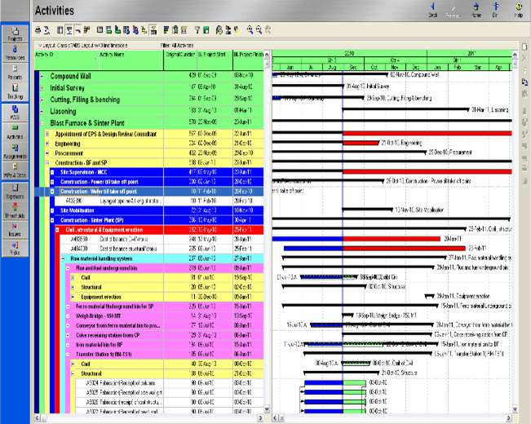
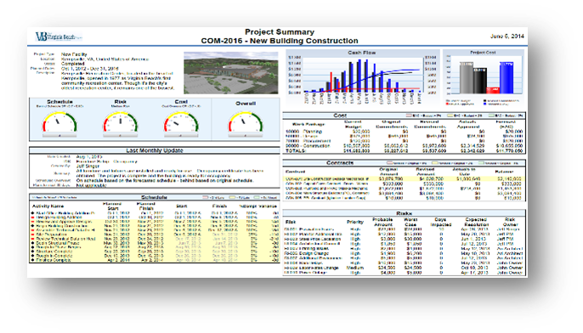
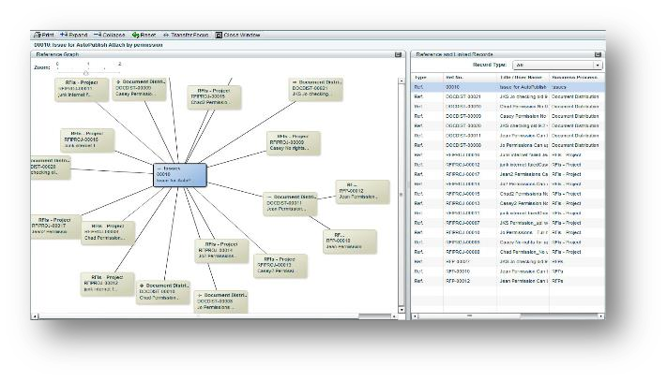
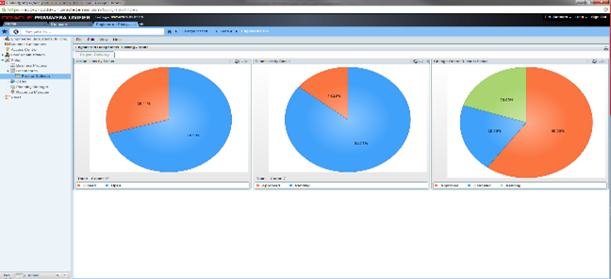
Monitoring and evaluation framework
Policy & Regulatory | Techno-Commercial | Program Management | Project Monitoring
Development of IT based Tool
Brief Description of key activities to be undertaken and deliverables
 | Manage Schedule | Assess current status of project and critically review existing schedules and systems. Suggest system to guide project and develop and implement same after discussions with management. Deliverables: Updated integrated project schedule Action plans for ensuring weekly and monthly targets
 | Generate Projections & Early Warnings | Sensitization to generate projected targets and discuss productivity parameters Review critical path of project and provide early warning for expected project delays Deliverable: Alert for project delays to all the stakeholders
 | Planning Work Front management | Forecast work plan by considering anticipated constraints and plan resource & stakeholder interference Testing/ modifying input data as required Deliverable: Work-front tracker for highlighting work front constraints
 | Digital Reporting | Generate MIS reports and dashboards, based on updated schedule and progress Enable select reports with scheduled automated circulations to the stakeholders Deliverables: Customized reports and dashboards/ MIS Interface
Develop Monitoring & Evaluation Plan
Design
Framework for independent & Immediate Quality Assessment
Implement
Evaluation of Project reports
Delivery
Tracking achievement of intended KPIs
Learning & Improvement
Progress Tracking
(through web portal)

Slide 23
Deloitte Team
Core Team & Project Governance

Slide 24
Details Of Our Team To Support JREDA
Individually and collectively, our team has the experience needed to deliver results in your business environment. The people in our team have led complex engagements and served major clients in your industry on similar engagements.
Core Team
RESPONSIBILITIES
Project Head
Manage relationship with your Top management.
Make key decisions, sign-off on major deliverables and has overall project responsibility.
Provide necessary guidance and oversight to the project team.
Provide final review of engagement deliverables.
Review all the documents and provide recommendation to JREDA.
Our experts bring in leading insights on RE Sector and Emerging Technologies.
Interact and coordinate with the Senior Management, key stakeholders of JREDA.
Ensure project objectives are met within timelines and scope outlined.
Provide progress update to JREDA management.
Part of the Steering Committee and shall join review meeting with the JREDA leadership.
Manage resources deployment and deliverable review.
Conduct all assigned tasks in the project.
Interface with client personnel on-site.
Draft required deliverables.
Support in Regulatory & Policy related matters.
End to End Support in Project and Project Management.
Rajneesh Sharma
B.Tech., MBA
16+ yrs. exp.
Team Leader
Arun K A
B.Tech., MBA
12+ yrs. exp.
RE Specialist
TA Specialist
Karan Chopkar
B.Tech., MBA
11+ yrs. exp.
Pranav Bargotra
B.E., M. Tech
08+ yrs. exp.
Program Associate-1
Program Associate-2
Bapi Kumar Das
B.Tech., M.Tech
05+ yrs. exp.
Ranjeet Singh Ajji
B.E., M. Tech
05+ yrs. exp.
Support Staff
Provide necessary guidance and oversight to the project team.
Provide final review of engagement deliverables.
Our pool of support staff has rich experience of working with Jharkhand utilities, Energy Department of Jharkhand and will bring in their expertise of understanding the Jharkhand Energy Sector.
Assist Core Team in conducting all assigned tasks in the project.
Support in Regulatory & Policy related matters, Bid Process management.
Support in required deliverables as and when required.
End to End Support in Project and Project Management.
Stakeholder management, Awareness programmes.
PMA & TA Expert
Strategy Expert
Tanudeep Mallick
B.Tech., MBA, 12+ yrs. exp.
Mohit Bhardwaj
B.Com., MBA
16+ yrs. exp.
Regulatory & Commercial Expert
Rishi Chatterjee
B.Tech., M.Tech, MBA, 05+ yrs. exp.

Slide 25
Thanks
Looking forward to commencing a long-term partnership

